Slide 1

1008_Introduction to Programming
Fundamentals of coding and software development basics
Compiled by Ms. Dianne Sikinapi & Ms. Odilia Tita
Notes:
AI-generated content may be incorrect. ---

Slide 2
LEARNING Objectives
By the end of this chapter, students should be able to;
Know what Programming is
Know the History of Computer Programming
Explore few examples of Computer Programs
Know what Programming Languages are, and the different Programming Languages
Know what Level or Generation of Languages are and the 5 Generation of Languages
Know what Language Translators are and the 2 Types of Translators, and,
Know the different ways to obtain computer programs in the market, and their advantages and disadvantages.
Reference: Textbook - Introduction to Programming Book 1 Pages 7 - 23
Notes:
The objectives of an Introduction to Programming course are designed to provide students with foundational knowledge and practical skills in computer programming. First, students will learn the fundamental concepts of programming, including variables, data types, control structures, and algorithms, which form the backbone of all programming languages. Second, the course aims to develop problem-solving abilities by teaching students how to break down complex problems into manageable steps and implement solutions using code. Third, students will gain hands-on experience with at least one programming language, such as Python or Java, to understand syntax, semantics, and debugging techniques. Additionally, the course emphasizes the importance of logical thinking and structured programming practices, which are essential for writing efficient and maintainable code. Another key objective is to introduce students to the software development life cycle, including planning, coding, testing, and documentation, to prepare them for real-world programming tasks. By the end of the course, learners should be able to write simple programs, understand how computers execute instructions, and appreciate the role of programming in modern technology. These objectives collectively ensure that students acquire both theoretical understanding and practical competence, laying a strong foundation for advanced programming courses and careers in software development.

Slide 3
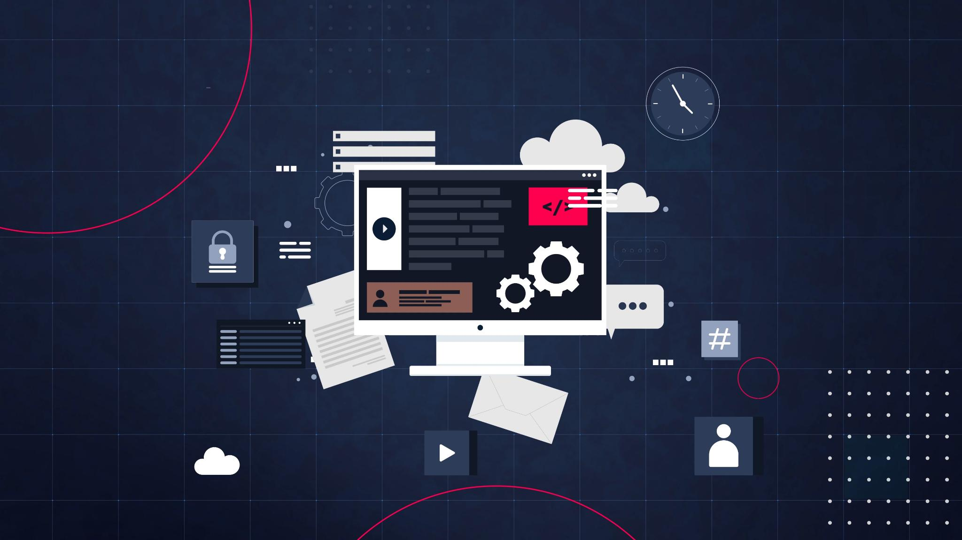
Course Objectives
Fundamental Programming Concepts
Students will learn variables, data types, control structures, and algorithms foundational to programming languages.
Problem-Solving Skills
The course develops problem-solving by teaching how to break down problems and implement coding solutions.
Hands-On Programming Experience
Students gain practical experience coding in languages like Python or Java, including syntax and debugging.
Software Development Life Cycle
Introduction to planning, coding, testing, and documenting software to prepare for real-world tasks.
Notes:
The objectives of an Introduction to Programming course are designed to provide students with foundational knowledge and practical skills in computer programming. First, students will learn the fundamental concepts of programming, including variables, data types, control structures, and algorithms, which form the backbone of all programming languages. Second, the course aims to develop problem-solving abilities by teaching students how to break down complex problems into manageable steps and implement solutions using code. Third, students will gain hands-on experience with at least one programming language, such as Python or Java, to understand syntax, semantics, and debugging techniques. Additionally, the course emphasizes the importance of logical thinking and structured programming practices, which are essential for writing efficient and maintainable code. Another key objective is to introduce students to the software development life cycle, including planning, coding, testing, and documentation, to prepare them for real-world programming tasks. By the end of the course, learners should be able to write simple programs, understand how computers execute instructions, and appreciate the role of programming in modern technology. These objectives collectively ensure that students acquire both theoretical understanding and practical competence, laying a strong foundation for advanced programming courses and careers in software development.

Slide 4
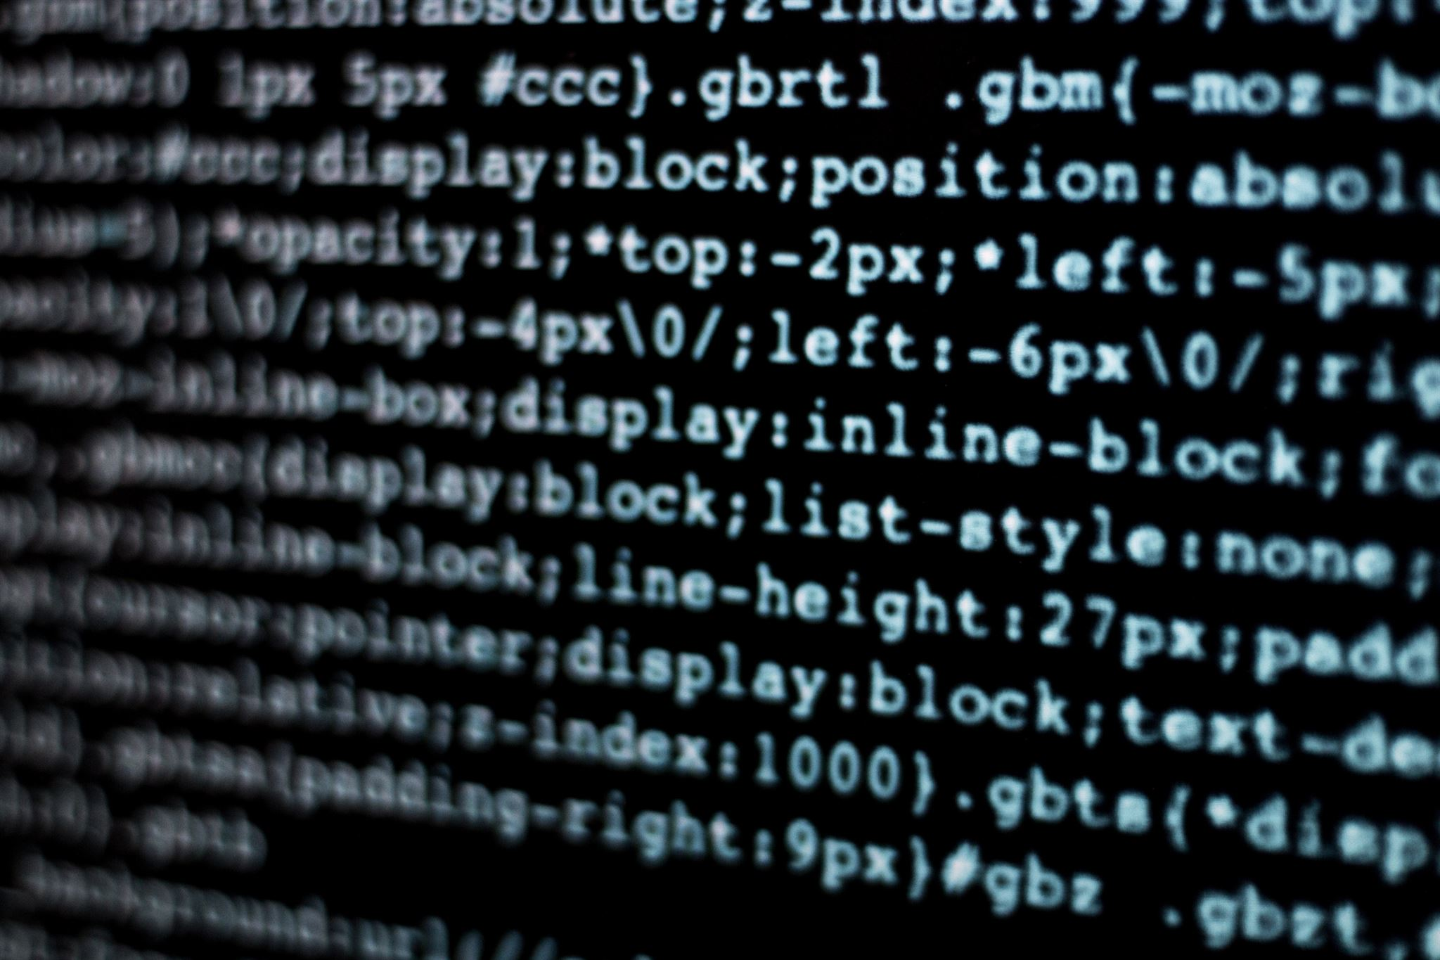
What is Programming?
Definition of Programming
Programming is the process of creating instructions that computers execute to perform tasks.
Programming Languages
Programs are written in languages that define operations like calculations and data manipulation.
Applications of Programming
Programming powers systems like web apps, AI, embedded devices, enabling automation in many fields.
Importance of Logical Thinking
Programming requires logic, attention to detail, and creativity to avoid errors and ensure functionality.
Notes:
Programming is the process of creating a set of instructions that a computer can execute to perform specific tasks. At its core, programming involves translating human ideas into a language that machines understand, enabling automation and problem-solving across countless domains. A program typically consists of statements written in a programming language, which define operations such as calculations, data manipulation, and decision-making. Programming is essential because computers cannot think independently; they rely on precise instructions to function. For example, when developing a simple calculator application, a programmer must define how the program accepts input, processes arithmetic operations, and displays results. Beyond basic tasks, programming powers complex systems like web applications, artificial intelligence, and embedded systems in devices. It also involves concepts such as algorithms, which are step-by-step procedures for solving problems efficiently. Programming requires logical thinking, attention to detail, and creativity, as errors or ambiguities in code can lead to unexpected results. Modern programming extends beyond writing code; it includes debugging, testing, and optimizing performance. Understanding programming is crucial for anyone pursuing careers in technology, as it underpins software development, data analysis, and automation in industries ranging from healthcare to finance.

Slide 5
1.1 What is (Computer) Programming?
Programming is a process which consists of a set of rules that provides a way of telling the computer what operation to perform. It is often referred to as Coding.
1.1.1 What is a Computer Program?
A program is simply a set of step-by-step instructions that direct the computer to do a task you want it to do and produce the result you want.
A program is also known to be a list of detailed instruction that the computer carries out. This means a program is the result/output of a processed set of instructions.
Programs are also saved instructions. You can save programs to the disk after you write them. When someone wants to execute the program, he/she instructs the computer to load the program from the disk into memory and then run the programs instructions.
1.1.2 Who is a Computer Programmer?
A computer programmer, sometimes referred to as a software developer, a software engineer, a programmer or a coder, is a person who creates computer programs.

Slide 6
1.1.3 How a Program works
As learnt that programs are also saved instructions, you can save programs to the disk after you write them (after they are created/developed). When someone wants to execute the program, he/she instructs the computer to load the program from the disk into memory and then run the programs instructions.
The computer’s internal memory is vital for program execution.
The computer’s CPU (Central Processing Unit) cannot execute a program directly from a disk. It must load the program from Disk into main Memory. The CPU has direct access to Memory but has no access to the Disk Drive.
The Disk is the long term storage and the Memory is the short-term storage where programs temporarily resides while the CPU executes them.
In order for a program to be executed by the computer, it must first be uploaded onto the Memory. While the program is in the memory, the CPU executes the program instruction.

Slide 7
Secondary Storage: stores data and programs
Input: sends data to central processing unit
Output: makes processed information available
Central Processing Unit
Control Unit Arithmetic/Logic Unit
Refer to Textbook Introduction to Programming Book 1, Pages 10 & 11 for an illustration.
Processing

Slide 8

Why Learn Programming?
Career Opportunities
Programming skills are highly sought after in fields like software development, AI, and cybersecurity.
Problem-Solving Skills
Programming enhances analytical thinking by breaking down complex problems into logical steps.
Automation Benefits
Programming enables automation, saving time and reducing errors in repetitive tasks.
Creativity and Innovation
Programming empowers creativity by allowing development of apps, games, and innovative tools.
Notes:
Learning programming offers numerous benefits, both professionally and personally. First, programming skills are in high demand across industries, making them essential for careers in software development, data science, cybersecurity, and emerging fields like artificial intelligence. Second, programming fosters problem-solving and analytical thinking, as it requires breaking down complex challenges into logical steps and implementing efficient solutions. For instance, writing a program to analyze large datasets teaches critical thinking and attention to detail. Third, programming enables automation, allowing individuals and organizations to save time and reduce errors by replacing manual tasks with software solutions. Additionally, programming empowers creativity, as developers can build applications, games, and tools that bring ideas to life. Beyond career opportunities, programming literacy enhances digital competence, helping individuals understand how technology works and interact with it effectively. In education, programming promotes computational thinking, which is increasingly recognized as a fundamental skill alongside reading and mathematics. Furthermore, learning programming opens doors to entrepreneurship, as many successful startups began with a simple coded prototype. Overall, programming is not just a technical skill but a gateway to innovation, efficiency, and adaptability in a technology-driven world.

Slide 9
Why learn Programming?
You may already have used software, perhaps for word processing or spreadsheets, or you may have used phone applications and programs for games or socializing.
Perhaps now you are curious to learn how programmers write software/programs/applications.
There are at least three good reasons for learning programming:
Programming helps you understand computers. The computer is only a tool. If you learn how to write simple programs, you will gain more knowledge about how a computer works.
Writing a few simple programs increases your confidence level. Many people find great personal satisfaction in creating a set of instructions that solve a problem.
Learning programming lets you find out quickly whether you like programming and whether you have the analytical turn of mind programmers need. Even if you decide that programming is not for you, understanding the process certainly will increase your appreciation of what programmers and computers can do.
Notes:
The objectives of an Introduction to Programming course are designed to provide students with foundational knowledge and practical skills in computer programming. First, students will learn the fundamental concepts of programming, including variables, data types, control structures, and algorithms, which form the backbone of all programming languages. Second, the course aims to develop problem-solving abilities by teaching students how to break down complex problems into manageable steps and implement solutions using code. Third, students will gain hands-on experience with at least one programming language, such as Python or Java, to understand syntax, semantics, and debugging techniques. Additionally, the course emphasizes the importance of logical thinking and structured programming practices, which are essential for writing efficient and maintainable code. Another key objective is to introduce students to the software development life cycle, including planning, coding, testing, and documentation, to prepare them for real-world programming tasks. By the end of the course, learners should be able to write simple programs, understand how computers execute instructions, and appreciate the role of programming in modern technology. These objectives collectively ensure that students acquire both theoretical understanding and practical competence, laying a strong foundation for advanced programming courses and careers in software development.

Slide 10
An important point before we proceed: You will not be a Programmer when you finish reading this chapter or even when you finish completing this subject. Programming proficiency takes practice and training beyond the scope of this class. However, you will become acquainted with how Programmers develop solutions to a variety of problems.
Notes:
The objectives of an Introduction to Programming course are designed to provide students with foundational knowledge and practical skills in computer programming. First, students will learn the fundamental concepts of programming, including variables, data types, control structures, and algorithms, which form the backbone of all programming languages. Second, the course aims to develop problem-solving abilities by teaching students how to break down complex problems into manageable steps and implement solutions using code. Third, students will gain hands-on experience with at least one programming language, such as Python or Java, to understand syntax, semantics, and debugging techniques. Additionally, the course emphasizes the importance of logical thinking and structured programming practices, which are essential for writing efficient and maintainable code. Another key objective is to introduce students to the software development life cycle, including planning, coding, testing, and documentation, to prepare them for real-world programming tasks. By the end of the course, learners should be able to write simple programs, understand how computers execute instructions, and appreciate the role of programming in modern technology. These objectives collectively ensure that students acquire both theoretical understanding and practical competence, laying a strong foundation for advanced programming courses and careers in software development.

Slide 11
1.2 Computer Programming History
Computer Programming is the very basis of the digital age that we live in today. Every time you like a post on social media, send an email, or set an alarm on your phone, a programming language is working behind the scenes – pulling the strings.
Today computers have an extensive genealogy. One of the earlier computing devices was the abacus. This machine is quite simple consisting of beads strung on a rod that are in turn mounted in a rectangular frame. As the beads are moved back and forth on the rods, their position represents stored values. It is the position of the beads that brings the idea of computers representing and storing data.

Slide 12
The first programming language was invented way back in 1843 by a female called Ada Lovelace. (She was often referred to as the Mother of Programming Languages.)
She came up with the first-ever machine algorithm for an early computing machine that she wrote down on a piece of paper because no computers existed at that time.
Programming languages have obviously come a long way. The first known programming languages were complicated machine codes that were manually inputted into early computing machines.
You will discover that computer programming developed quickly from machine codes to fully automated human-readable code.

Slide 13

Early Beginnings
Ada Lovelace and Conceptual Foundation
Ada Lovelace pioneered programming concepts with her work on the Analytical Engine, envisioning machine-executed operations beyond calculations.
Early Electronic Computers
World War II era computers like ENIAC introduced electronic calculation but required manual wiring and switches.
Machine and Assembly Languages
Machine language with binary codes and assembly language with symbols made programming more accessible and programmable.
Transition to Modern Programming
The shift from mechanical to electronic computing enabled faster processing and laid groundwork for high-level languages.
Notes:
The history of computer programming dates back to the early 19th century with pioneers like Ada Lovelace, who is often credited as the first programmer for her work on Charles Babbage’s Analytical Engine. Lovelace envisioned how machines could execute sequences of operations beyond mere calculation, laying the conceptual foundation for programming. In the mid-20th century, the development of electronic computers during World War II accelerated programming innovations. Early computers like ENIAC required manual wiring and switches to perform calculations, which was cumbersome and error-prone. This led to the creation of machine language, the most basic form of programming, consisting of binary instructions directly understood by hardware. As computing needs grew, assembly language emerged, introducing symbolic representations for machine instructions, making programming slightly more accessible. These early developments were crucial because they established the principles of instruction sequencing and algorithmic thinking that underpin modern programming. The evolution from mechanical computation to electronic systems marked a turning point, enabling faster processing and paving the way for higher-level languages that abstracted hardware complexity. Understanding these beginnings provides insight into how programming evolved from a niche technical task to a cornerstone of modern technology.

Slide 14

Development of High-Level Languages
Early High-Level Languages
FORTRAN and COBOL emerged in the 1950s to simplify coding for scientific and business applications.
Structured Programming
The 1970s introduced structured programming with C, enhancing modularity and code readability.
Object-Oriented Programming
Languages like C++ and Java enabled modeling of real-world entities using classes and objects.
Scripting Languages Emergence
Python and JavaScript in the 1990s promoted simplicity and rapid development for diverse applications.
Notes:
High-level programming languages emerged in the 1950s and 1960s to simplify coding and make it more accessible to humans. FORTRAN (Formula Translation), introduced in 1957, was one of the first widely used high-level languages, designed for scientific and engineering applications. COBOL (Common Business-Oriented Language) followed in 1959, catering to business data processing needs. These languages allowed programmers to write instructions using English-like syntax rather than binary or assembly code, significantly reducing complexity. The 1970s saw the rise of structured programming with languages like C, which introduced modularity and improved code readability. Later, object-oriented programming gained prominence with languages such as C++ and Java, enabling developers to model real-world entities through classes and objects. The advent of scripting languages like Python and JavaScript in the 1990s further democratized programming by emphasizing simplicity and rapid development. Each generation of languages addressed limitations of its predecessors, improving portability, efficiency, and maintainability. Today, high-level languages dominate software development, supporting diverse applications from web development to artificial intelligence. Their evolution reflects a continuous effort to balance human readability with machine efficiency, shaping the modern programming landscape.

Slide 15

Modern Programming Trends
Open-Source Collaboration
Open-source development fosters community innovation and collaboration through projects like Linux and Python.
Cloud Computing Importance
Cloud computing drives scalable application development leveraging distributed resources and infrastructure.
AI and Machine Learning
AI frameworks like TensorFlow enable building intelligent systems and machine learning applications.
Security and Low-Code Platforms
Security-focused programming and low-code platforms democratize development and protect against cyber threats.
Notes:
Modern programming trends are driven by advancements in technology and changing user needs. One major trend is the rise of open-source development, which fosters collaboration and innovation through community-driven projects like Linux and Python. Another significant trend is the growing importance of cloud computing, requiring developers to build scalable applications that leverage distributed resources. Mobile app development has also surged, with languages like Swift and Kotlin tailored for iOS and Android platforms. Additionally, artificial intelligence and machine learning have introduced specialized frameworks such as TensorFlow and PyTorch, enabling developers to create intelligent systems. Programming paradigms continue to evolve, with functional programming gaining traction for its emphasis on immutability and concurrency, as seen in languages like Haskell and Scala. Security-focused programming has become critical due to increasing cyber threats, leading to practices like secure coding and vulnerability testing. Furthermore, low-code and no-code platforms are emerging, allowing non-programmers to create applications through visual interfaces, democratizing software development. These trends highlight programming’s dynamic nature, where adaptability and continuous learning are essential for staying relevant in a rapidly changing technological landscape.

Slide 16
1.3 Examples of Computer Programs
Computer programs, also known as software or applications, are sets of instructions that tell a computer how to perform specific tasks. They come in various types and serve a wide range of purposes. Here are some examples of computer programs:
Web Browsers: Programs like Google Chrome, Mozilla Firefox, and Microsoft Edge allow users to access and browse websites on the internet.
Word Processors: Applications like Microsoft Word, Google Docs, and Apple Pages enable users to create, edit, and format documents.
Spreadsheets: Programs like Microsoft Excel, Google Sheets, and LibreOffice Calc are used for organizing, analyzing, and manipulating data in tabular form.
Media Players: Applications like VLC Media Player, Windows Media Player, and iTunes allow users to play audio and video files on their computers.
Image Editors: Software such as Adobe Photoshop, GIMP, and Paint.NET enable users to edit and manipulate images and graphics.
These examples only scratch the surface of the vast array of computer programs available today. Each program serves a specific purpose and contributes to the rich and diverse ecosystem of software applications that shape our digital lives.

Slide 17

Overview of Programming Languages
Low-Level Languages
Low-level languages interact directly with hardware, offering speed and control but requiring deep architecture knowledge.
High-Level Languages
High-level languages abstract hardware complexity, enabling easier problem-solving and faster development.
Programming Paradigms
Languages follow paradigms like procedural, object-oriented, and functional programming to model problems differently.
Purpose and Selection
Choosing a language depends on project needs, performance, and developer expertise for effective solutions.
Notes:
Programming languages are formal systems of communication used to instruct computers. They vary widely in syntax, semantics, and application domains. Broadly, languages can be categorized into low-level and high-level types. Low-level languages, such as machine code and assembly, interact closely with hardware, offering speed and control but requiring detailed knowledge of computer architecture. High-level languages, like Python, Java, and C++, abstract hardware complexity, enabling developers to focus on problem-solving rather than machine-specific details. Each language serves specific purposes: Python excels in data science and automation, Java dominates enterprise applications, and C++ is favored for performance-critical systems. Languages also differ in paradigms, such as procedural, object-oriented, and functional programming, which influence how problems are modeled and solved. Choosing the right language depends on factors like project requirements, performance needs, and developer expertise. Understanding the diversity of programming languages is essential for selecting appropriate tools and adapting to evolving technologies.

Slide 18

Levels of Programming Languages
Machine and Assembly Languages
Machine language uses binary instructions executed by the CPU, while assembly uses mnemonics needing hardware knowledge.
High-Level Languages
Languages like Python and Java provide human-readable syntax and rely on compilers or interpreters for execution.
Fourth-Generation Languages
4GLs such as SQL simplify programming by focusing on problem solving instead of procedural details.
Trade-offs in Language Levels
Lower levels offer speed and precision; higher levels prioritize ease of use and portability.
Notes:
Programming languages are classified into levels based on their abstraction from hardware. Machine language, the lowest level, consists of binary instructions directly executed by the CPU. While efficient, it is difficult for humans to read and write. Assembly language offers a slight improvement by using mnemonic codes for operations, but still requires detailed hardware knowledge. High-level languages, such as Python, Java, and C#, provide significant abstraction, allowing programmers to write code using human-readable syntax. These languages rely on translators like compilers and interpreters to convert code into machine-executable form. Fourth-generation languages (4GLs), such as SQL, further simplify programming by focusing on problem-solving rather than procedural details. Each level represents a trade-off between control and convenience: lower levels offer speed and precision, while higher levels prioritize ease of use and portability. Understanding these levels helps programmers choose the right language for tasks ranging from embedded systems to enterprise applications.

Slide 19
1.4 Programming Languages
A Programming Language is a way for Programmers (Developers) to communicate with computers. It is actually a set of commands or instructions and other syntax used to create a software program.
Therefore, a set of rules that provides a way of telling a computer what operations to perform is called a programming language.
There is not, however, just one programming language; there are hundreds of programming languages that are used.
Refer to pages 12 & 13 of Introduction to Programming Book 1 to read about a few examples of Programming Languages.

Slide 20
1.4.1 Top Programming Languages
In the programming world, there is an organization that assess and indicates the popularity of all programming languages. This organization is called the TIOBE Programming Community .
TIOBE stands for The Importance Of Being Earnest.
TIOBE measures all programming languages used to developed all software applications and programs that are used all over the world and rate them according to their popularity.
The TIOBE index is updated every month. According to the TIOBE index of July 2023, the top 10 programming languages are:
1. Python | 6. JavaScript
2. C | 7. Visual Basic
3. C++ (C Plus Plus) | 8. SQL (Structured Query Language)
4. Java | 9. PHP (Hypertext Preprocessor)
5. C# (C Sharp) | 10. MATHLAB

Slide 21
1.5 Level of Language
There are many programming languages that are in common use today, such as Java, C, Python, Pascal, etc. All these programming languages are said to be either higher level language or lower level language depending on how close they are to the languages the computer itself uses, (that is 0’s and 1’s).
Low-level languages are considered to be closer to computers. In other words, their prime function is to operate, manage and manipulate the computing hardware and components. Programs and applications written in a low-level language are directly executable on the computing hardware without any interpretation or translation.
Machine language and assembly language are popular examples of low-level languages.
There is a big difference between higher-level and lower-level languages.

Slide 22
Table showing differences between Higher-level and Lower-level Languages
High-Level Languages | Low-Level Languages
Easy to learn and understand. | Challenging to learn and understand.
Executed slower than lower level languages because they require a translator program. | Execute with high speed.
Do not provide many facilities at the hardware level. | Very close to the hardware and help to write a program at the hardware level.
Writing programs, hardware knowledge is not required. | Writing programs, hardware knowledge is a must.
Programs are easy to modify. | Modifying programs is difficult.
A single statement may execute several instructions. | The statements can be directly mapped to processor instructions.
BASIC, Perl, Pascal, COBOL, Ruby etc. are examples of High-Level Languages. | Machine language and Assembly language are Low-Level Languages.

Slide 23
1.6 Generation of Languages
There are five (5) generation of programming languages.
In terms of ease of use and capabilities, each generation is an improvement over its predecessor.
The Five Generation of Languages are:
Machine Language – 1GL (First Generation of Language)
Assembly Language – 2GL (Second Generation of Language)
High-Level Language – 3GL (Third Generation of Language)
Very High-Level Language – 4GL (Fourth Generation of Language)
Natural Language/Artificial Intelligence – 5GL (Fifth Generation of Language)

Slide 24
1. Machine Language (1GL)
Humans do not like to deal in numbers alone, they prefer letters and words. But, strictly speaking, numbers are what machine language is.
Machine Language is the lowest level of language, that represents data and program instructions as 0’s and 1’s (binary digits). It is the only language that is understood by computers.
A low-level language may also be referred to as a computer’s native language.
Each type of computer has its own machine language. Since computers are digital devices, they only recognized binary data. Every program, video, image, and characters of text is represented in binary. This binary data or machine language/code is processed as input by the CPU. The resulting output is sent to the operating system or an application, which displays the information that we see.
Primitive by today's standards, the programs were not convenient for people to read and use. The computer industry quickly moved to develop assembly languages.

Slide 25
2. Assembly Language (2GL)
One step above Machine Language is Assembly Language.
Today, assembly languages are considered very low level. That is, they are not as convenient for people to use as more recent languages. At the time they were developed, however, they were considered a great leap forward. To replace the 0’s and 1’s used in machine language, assembly languages use mnemonic codes, abbreviations that are easy to remember: A for Add, C for Compare, MP for Multiply, STO for storing information in memory, and so on. Although these codes are not English words, they are, still, from the standpoint of human convenience-preferable to numbers (0’s and 1s) alone.
Just like machine language, each type of computer has its own assembly language.
Assembly Language programs are translated into machine code by an assembler. The assembler acts as a translator. A translator is needed because machine language is the only language the computer can actually execute. The assembler takes the programs written in assembly language and turns them into machine language.
Although assembly languages represent a step forward, they still have many disadvantages. A key disadvantage is that assembly language is detailed in the extreme, making assembly programming repetitive, tedious, and error prone.

Slide 26
3. High-Level Language (3GL)
A High-Level language is a programming language designed to simplify computer programming. It enables development of a program in a much more user-friendly programming context and is generally independent of the computer's hardware architecture.
The first widespread use of high-level languages in the early 1960s transformed programming into something quite different from what it had been. Programs were written in an English-like manner, thus making them more convenient to use. As a result, a programmer could accomplish more with less effort, and programs could now direct much more complex tasks.
These so-called third-generation languages spurred the great increase in data processing that characterized the 1960s and 1970s. During that time the number of mainframes in use increased from hundreds to tens of thousands. The impact of third-generation languages on our society has been enormous.
Of course, a translator is needed to translate the symbolic statements of a high-level language into computer-executable machine language; this translator is usually a compiler. There are many compilers for each language and one for each type of computer. Some languages are created to serve a specific purpose, such as controlling industrial robots or creating graphics.
High-Level languages are used to solve problems and are often described as problem-oriented languages. In contrast, low-level languages such as assembly languages, closely reflect the machine codes for specific computers, and are therefore described as machine-oriented languages.

Slide 27
4. Very High-Level Language (4GL)
Very High-Level Language is a high level programming language designed to reduce the complexity and amount of source code required to create a program. It incorporates higher data and control abstraction abilities.
A very high level programming language is also known as a goal-oriented programming language. Languages called very high-level languages are often known by their generation number, that is, they are called fourth-generation languages or, more simply, 4GLs.
The 4GLs are essentially shorthand programming languages. An operation that requires hundreds of lines in a third-generation language typically requires only five to ten lines in a 4GL.
However, beyond the basic criterion of conciseness, 4GLs are difficult to describe. This is because 4GLs are still evolving, and that which is still evolving cannot be fully defined or standardized.

Slide 28
5. Natural Language [Artificial Intelligence] (5GL)
The word "natural" has become almost as popular in computing circles as it has in a normal environment. Natural means human-like.
Natural Language is the newest level of language and is called the fifth-generation language (5GLs) that produces natural language as output. 5GLs are, as you may guess, even more ill-defined than 4GLs. They are most often called natural languages because of their resemblance to the "natural" spoken English language.
Natural language generation (NLG) is the process of generating text that appears to be written by a human, without the need for a human to actually write it
Instead of being forced to key correct commands and data names in correct order, a user tells the computer what to do by keying in his or her own words. Such a request may contain misspelled words, lack articles and verbs, and even use slang.
The natural language translates human instructions which can contain bad grammar, slang, and all, into code the computer understands. If it is not sure what the user has in mind, it politely asks for further explanation.
Natural languages are sometimes referred to as knowledge-based languages, because natural languages are used to interact with a base of knowledge on some subject. The use of a natural language to access a knowledge base is called a knowledge-based system.

Slide 29
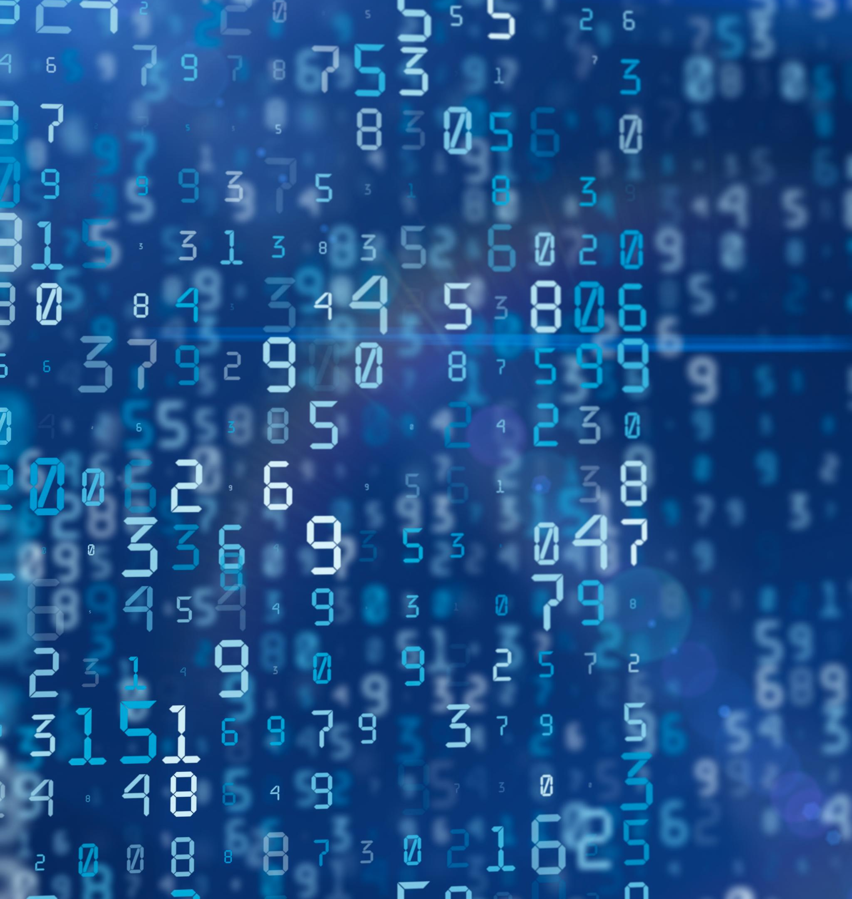
Compilers and Interpreters
Compiler Functionality
Compilers translate full source code into executable files before running programs, enhancing execution speed.
Interpreter Process
Interpreters execute code line by line, supporting scripting and quick development with easy debugging.
Hybrid Compilation Models
Hybrid models like Just-In-Time compilation combine benefits of both compilers and interpreters for optimized performance.
Notes:
Language translators are essential tools that convert high-level programming code into machine-readable instructions. Compilers translate the entire source code into executable files before running the program, offering faster execution but requiring a compilation step. Examples include C and Java compilers. Interpreters, on the other hand, execute code line by line, making them ideal for scripting and rapid development. Python and JavaScript commonly use interpreters, enabling flexibility and ease of debugging. Each approach has advantages: compilers optimize performance and detect errors early, while interpreters allow dynamic execution and platform independence. Hybrid models, such as Just-In-Time (JIT) compilation used in Java, combine benefits of both methods. Understanding these translators is crucial for selecting languages and tools that align with project requirements, balancing speed, portability, and development efficiency.

Slide 30
1.7 Language Translators
Computers cannot understand any programming languages. This is so because computers cannot simply understand English, or any other languages that people speak.
Even so the computers cannot understand any programming language, it is easy for that program to be understood by the computers, and this is with the help of a software tool called a Language Translator.
The instruction you give into your program must be in the language the computer understands.
Translators are software’s or programs that translates a programming language (codes written by Programmers using a programming language) into machine language (computer language) that the computer understands which means it can interpret and responds to the request.
There are two kinds of Language Translators and they both take a programming language and translates it into a form readable by the computer. Each of these translators takes a different approach but their results are the same. These two translators are:
Compiler
Interpreter

Slide 31
Diagram showing how an Interpreter and Compiler translates codes

Slide 32
i. Compiler
A compiler is system software (a set of a computer program) that converts source code written in a programming language (source language, usually HLL) into another computer language (target language). It processes every statement written in a particular programming language and turns them to machine language.
Instead of translating one line at a time, Compilers translate the entire program at one time.
Most businesses prefers compiled programming language because once compiled, the program must run faster than they would if they were interpreted.
Some of todays programming languages enable you to run programs interpreted as well as compiled.

Slide 33
1.7.1 Difference between a Compiler and an Interpreter
Both Compiler and Interpreter work to convert high-level language to machine understandable code and then back to high-level code, but there are some differences in their working.
Compiler | Interpreter
Considers the completion of your program as input for converting to machine code. | Considers 1 statement in your program at a time as input for converting to machine code.
Usually generates intermediate code in the form of the object file (.obj). | Doesn't create an intermediate object (.obj) code.
Faster execution of control statements as compared to the interpreter. | Slower execution of control statements as compared to the compiler.
Detected errors in the program get displayed after the entire program is read by compiler. | Detected errors in the program get displayed after each instruction read by the interpreter.

Slide 34
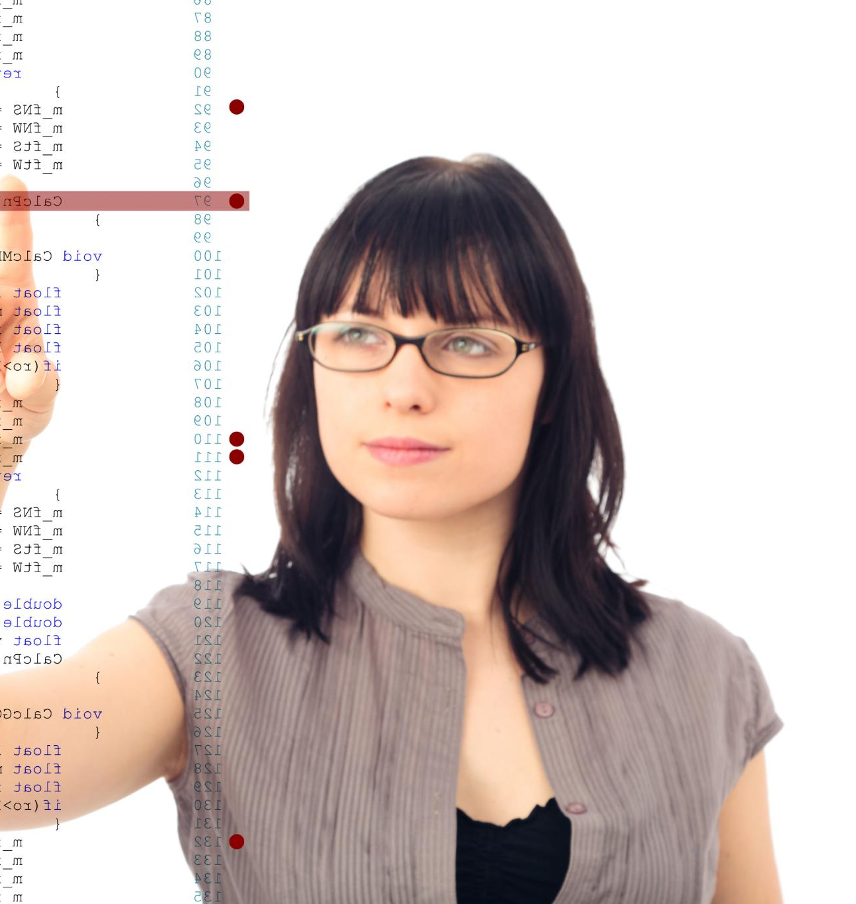
Assemblers and Other Translators
Role of Assemblers
Assemblers translate assembly language to machine code, enabling precise hardware control and efficient executable programs.
Linkers and Loaders Function
Linkers combine multiple object files into one executable, while loaders prepare programs for execution in memory.
Modern Development Tools
Development environments integrate syntax checking, optimization, and debugging tools to streamline translation and improve software quality.
Notes:
Assemblers are specialized translators that convert assembly language into machine code. They play a critical role in low-level programming, where precise control over hardware is required. Unlike compilers and interpreters, assemblers deal with symbolic instructions and memory addresses, producing highly efficient executable code. Other translation tools include linkers, which combine multiple object files into a single executable, and loaders, which prepare programs for execution in memory. Additionally, modern development environments incorporate integrated tools for syntax checking, optimization, and debugging, streamlining the translation process. Understanding these components helps programmers appreciate the complexity of converting human-readable code into machine instructions, ensuring efficient and reliable software execution.

Slide 35

Commercial and Open-Source Software
WAYS OF OBTAINING PROGRAMS
Commercial Software Features
Commercial software offers professional support, regular updates, and strong security, typically with upfront or subscription fees.
Open-Source Software Benefits
Open-source software provides free source code access for customization and relies on community-driven improvements.
Choosing Software Types
Selection depends on budget, technical skills, and project needs; hybrid usage combines benefits of both software types.
Notes:
Programs can be obtained through various channels, each with distinct advantages and limitations. Commercial software, often sold under proprietary licenses, provides professional support, regular updates, and robust security features. Examples include Microsoft Office and Adobe Photoshop. However, it typically involves upfront costs or subscription fees. Open-source software, such as Linux and LibreOffice, offers free access to source code, enabling customization and community-driven improvements. While cost-effective, open-source solutions may lack dedicated support, requiring users to rely on forums and documentation. Choosing between commercial and open-source software depends on factors like budget, technical expertise, and project requirements. Organizations often adopt hybrid strategies, combining proprietary tools with open-source components to balance cost and functionality.

Slide 36

Freeware, Shareware and Licensing
Freeware Overview
Freeware is software available at no cost, often including limitations or advertisements.
Shareware Trial Model
Shareware offers trial periods with limited features before purchase.
Software Licensing Types
Licensing governs user rights, from single-user to enterprise agreements.
Software-as-a-Service (SaaS)
SaaS offers subscription-based cloud access to applications for flexible usage.
Notes:
Freeware refers to software distributed at no cost, such as web browsers and media players, though it may include limitations or advertisements. Shareware allows users to try software before purchasing, often with restricted features or time-limited trials. Licensing models govern software usage rights, ranging from single-user licenses to enterprise agreements. Understanding these models is crucial for compliance and cost management. For instance, violating license terms can lead to legal consequences and financial penalties. Additionally, software-as-a-service (SaaS) models have gained popularity, offering subscription-based access to applications hosted in the cloud. These diverse acquisition methods provide flexibility for individuals and organizations, enabling them to select solutions that align with their needs and resources.

Slide 37
Summary of Key Points
Programming Overview
The presentation began with clear course objectives and the fundamental definition of programming.
Historical Evolution
Programming evolved from early mechanical systems to modern open-source and cloud computing trends.
Languages and Paradigms
Programming languages were classified into low-level and high-level, emphasizing their roles and paradigms.
Language Translators
Compilers, interpreters, and assemblers convert human code into machine instructions.
Software Acquisition
Programs can be obtained through commercial software, open-source, or various licensing models.
Notes:
This presentation covered essential aspects of programming, starting with course objectives and the definition of programming. We explored its historical evolution from early mechanical systems to modern trends like open-source development and cloud computing. Programming languages were categorized into low-level and high-level types, highlighting their roles and paradigms. Language translators, including compilers, interpreters, and assemblers, were discussed for their importance in converting human-readable code into machine instructions. Finally, we examined ways of obtaining programs, from commercial software to open-source solutions and licensing models. Understanding these concepts provides a solid foundation for further study and practical application in software development.

Slide 38

Future of Programming
Impact of AI and Machine Learning
AI and machine learning are transforming programming paradigms and require mastery of specialized frameworks and algorithms.
Quantum Computing Revolution
Quantum computing introduces new languages and models designed to solve complex problems in novel ways.
Democratization via Low-Code Platforms
Low-code and no-code platforms enable non-programmers to develop applications through intuitive interfaces.
Security and Cross-Disciplinary Growth
Security remains essential while programming intersects with IoT, robotics, and biotechnology innovations.
Notes:
The future of programming is shaped by emerging technologies and evolving user needs. Artificial intelligence and machine learning will continue to influence programming paradigms, requiring developers to master specialized frameworks and algorithms. Quantum computing promises to revolutionize problem-solving, introducing new languages and models optimized for quantum systems. Low-code and no-code platforms will democratize software development, enabling non-programmers to create applications through intuitive interfaces. Additionally, security and privacy will remain critical, driving advancements in secure coding practices and compliance standards. As automation and connectivity expand, programming will increasingly intersect with fields like IoT, robotics, and biotechnology. Continuous learning and adaptability will be essential for programmers to thrive in this dynamic landscape, ensuring they remain at the forefront of innovation.

Slide 39
Summary and Review Exercises
Read Chapter Summary Notes on Page 22 of Introduction to Programming Book 1.
Complete all 5 review questions on Page 23 of Introduction to Programming Book 1.

